Slide 1
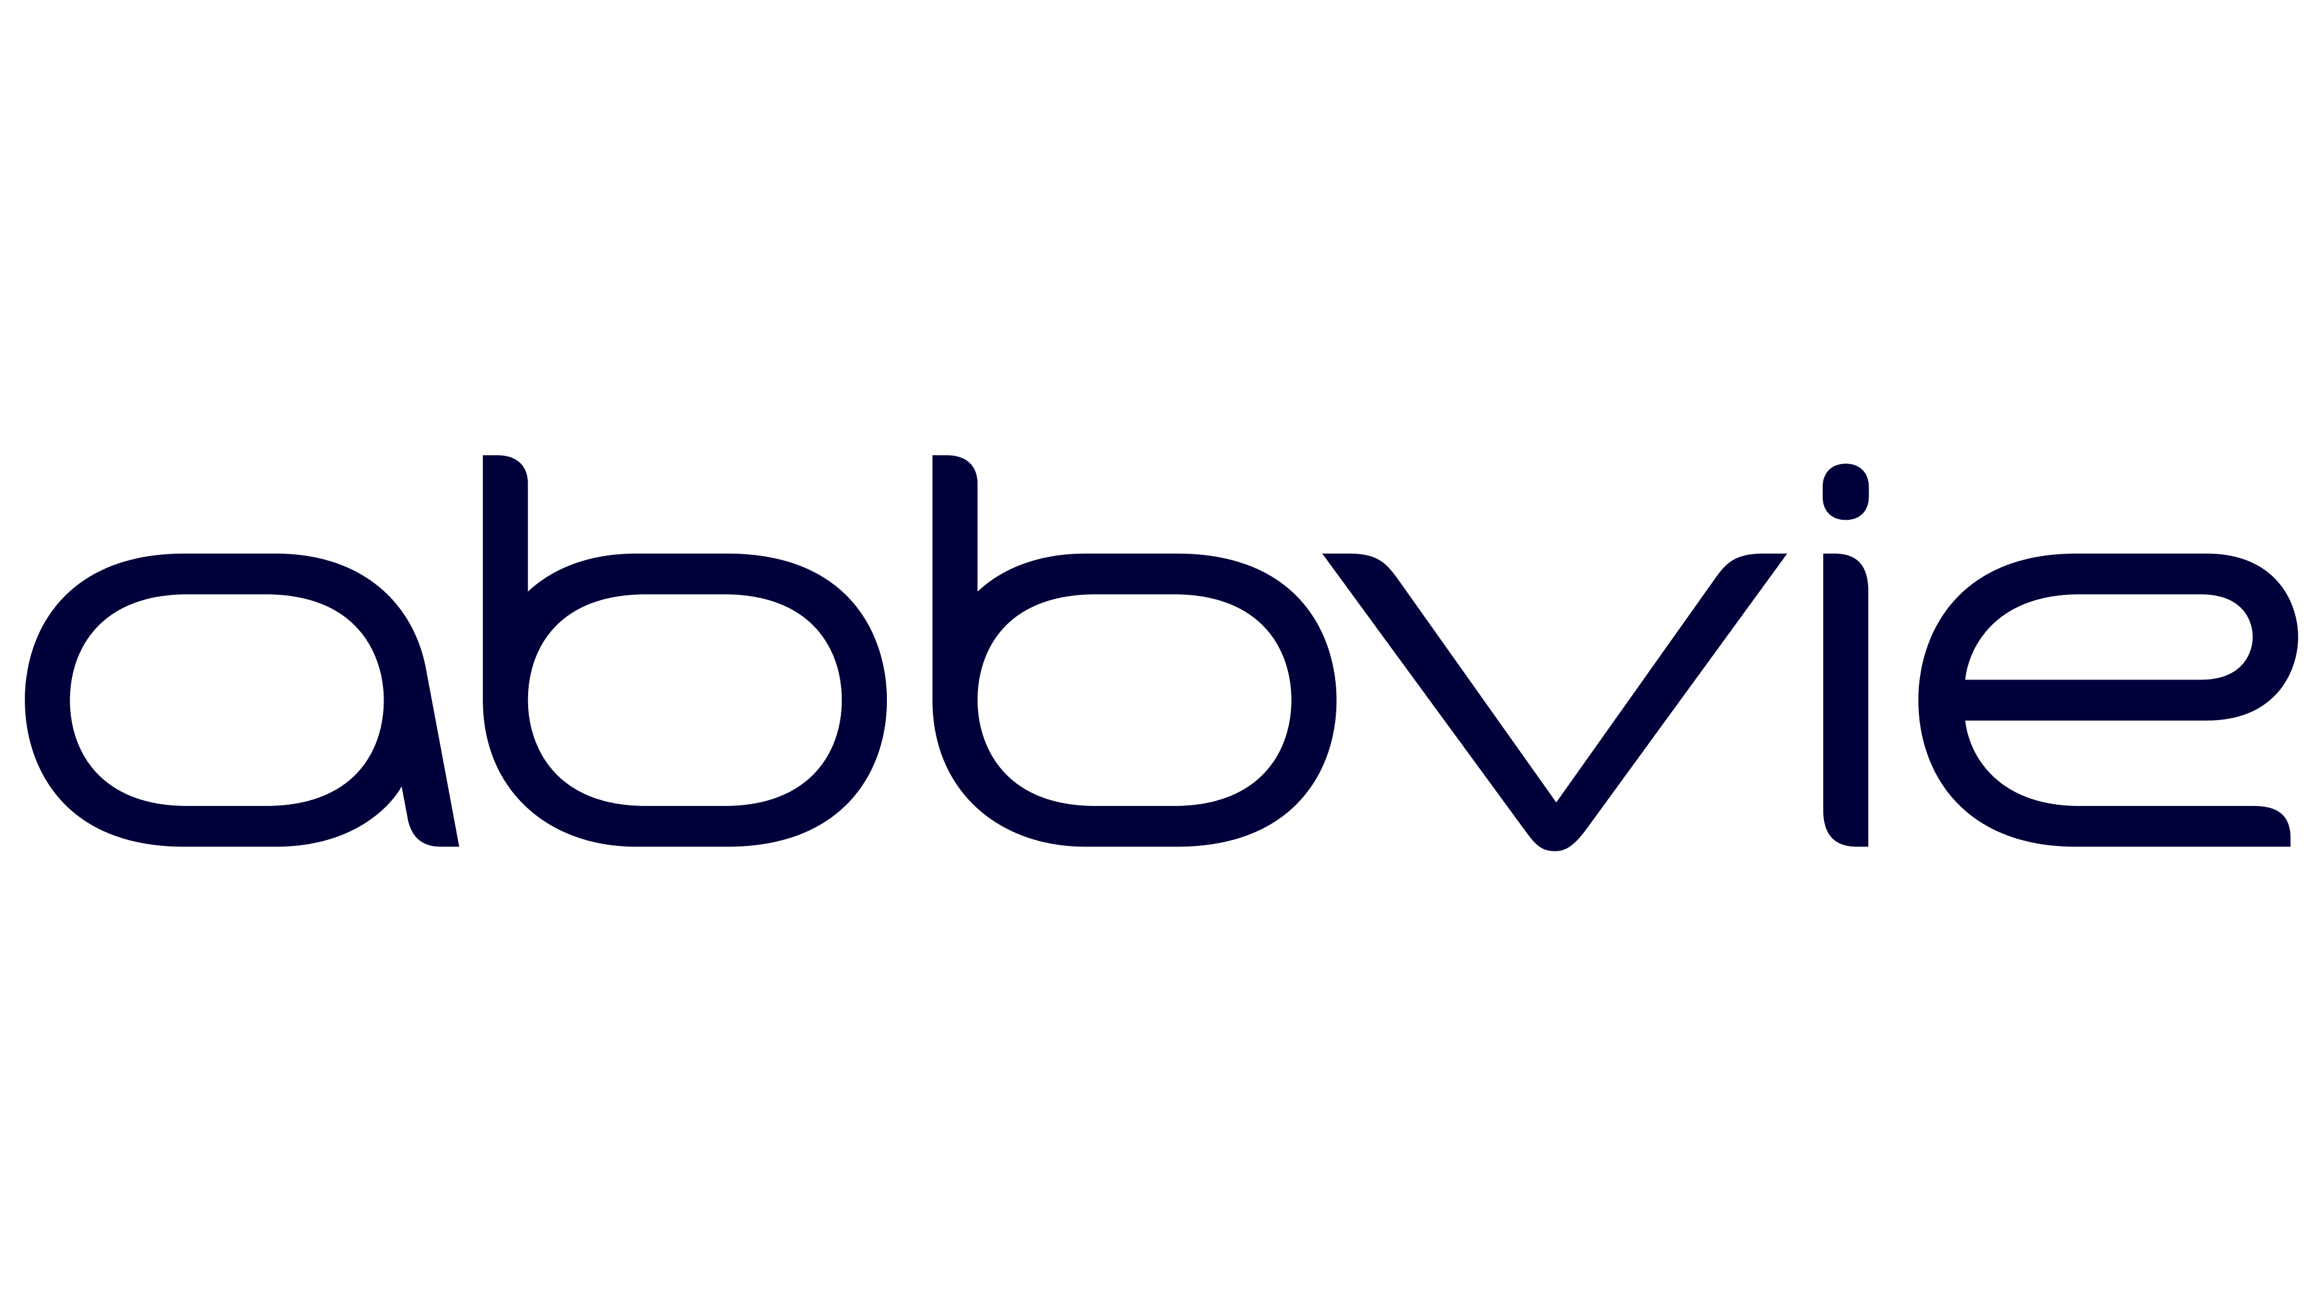

When luminal colloids drive PROTAC intestinal absorption: mechanistic insights for formulation design
PhysChem Forum 2026
Janis Niessen
PhD student at Translational Drug Discovery and Development,
Dpt. of Pharmaceutical Biosciences, Uppsala University

Slide 2
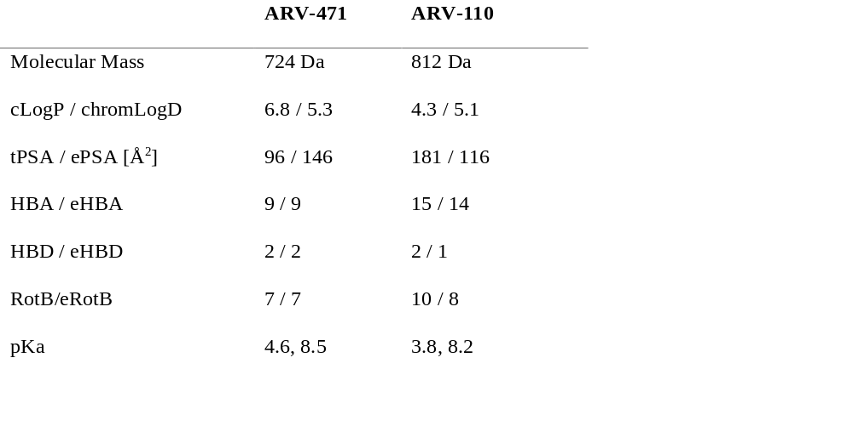
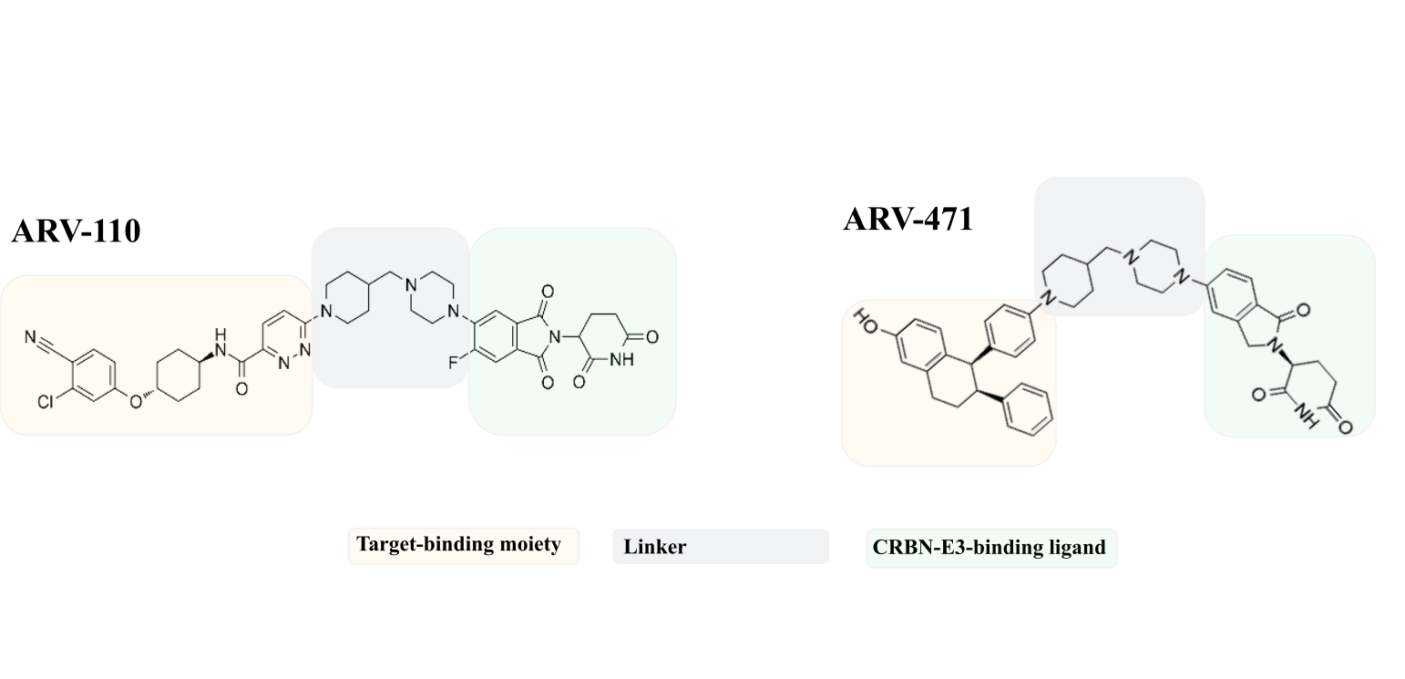
Translational challenges in the PROTAC chemical space
A molecular architecture driving unique pharmacology yet hindering clinical translation:
PROTAC Challenges
Size
Generally “beyond rule of five” molecules
Implies poor intestinal absorption & oral bioavailability (BCS II or IV)
Poor mass balance recovery in standard in vitro assays
Often strong mismatch between in silico/in vitro predictions and in vivo outcomes
Permeability
Lipophilicity
Solubility, non-specific binding in vitro
Polarity
Permeability
Flexibility
Solid state properties, in silico prediction
Chameleonicity
(Schade et al., 2024)
2

Slide 3
Translational challenges in the PROTAC chemical space
A molecular architecture driving unique pharmacology yet hindering clinical translation:
What is needed to support PROTAC clinical translation?
Size
Permeability
Lipophilicity
Solubility, non-specific binding in vitro
Robust methods for reliable characterization
Defining the limiting processes in intestinal absorption
Tailored oral drug delivery strategies for enhanced bioavailability
Polarity
Permeability
Flexibility
Solid state properties, in silico prediction
Chameleonicity
(Schade et al., 2024)
3

Slide 4
What are the true intestinal absorption barriers for PROTACs?
How do PROTAC colloids affect intestinal absorption?
What can we learn from this for rational formulation development?

Slide 5


Outline – From characterization to formulation
Biopharmaceutics
characterization
PROTAC colloidal dynamics
Formulation development
Biopharmaceutics toolbox for PROTACs
in vivo and in vitro assays
Comprehensive PROTAC characterization
Identifying absorption-limiting processes at clinically relevant doses
Mechanistic investigations of PROTAC luminal colloids
in vitro physicochemical characterization
of luminal colloids
in vivo effects of luminal colloids on PROTAC intestinal absorption
Implications for formulation design
Case study – How Permeation Enhancers (PEs) boost intestinal absorption
5

Slide 6
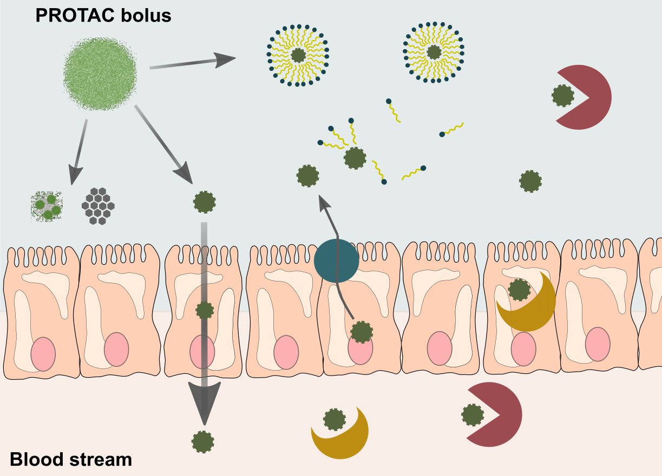
What is governing PROTAC intestinal absorption?
Solubility/
Dissolution states
Biopharmaceutics
characterization
Permeability & P-gp
Biopharmaceutics toolbox for PROTACs
in vivo and in vitro assays
Comprehensive PROTAC characterization
Identifying absorption-limiting processes at clinically relevant doses
Luminal degradation
CYP3A-mediated metabolism
6

Slide 7
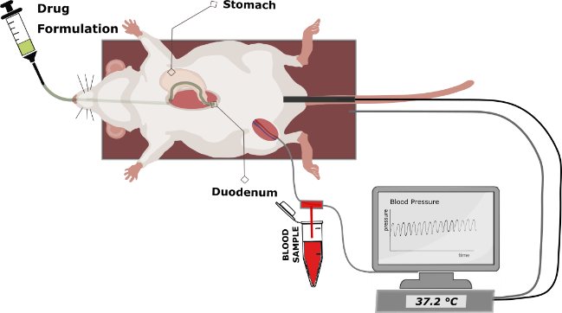
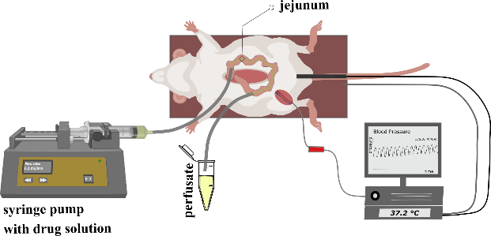
Integrated in vivo-in vitro testing approach for PROTACs
Translational in vivo models – complex & dynamic processes
Biopharmaceutics
characterization
Intraduodenal bolus
Single-Pass Intestinal Perfusion (SPIP)
Solubility
Amorphous/Crystalline, Biorelevant
Dissolution Dynamics
Precipitation, Solid State, Solubilization
Luminal stability
Enzymatic degradation
Intestinal permeability
P_{eff}, P-gp efflux
First-pass extraction
Enzymatic gut-wall and hepatic extraction
Dynamic physiological factors affecting drug absorption captured: neuroendocrine feedback mechanisms, transit, peristalsis...
in vivo flux (and P_{eff}) can be calculated based on plasma exposure
Not always possible to assess isolated absorption mechanism
Permeability testing under intact intestinal physiology and controlled luminal conditions
Can be applied to assess luminal stability or excipient effects
Requires extensive non-specific binding studies and customization for PROTACs
!
!
7

Slide 8
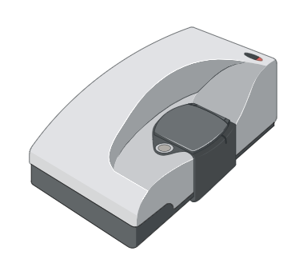
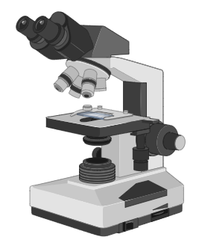
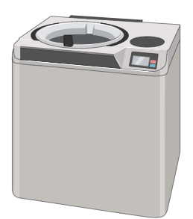
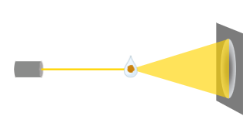
Integrated in vivo-in vitro testing approach for PROTACs
Translational in vivo models – complex & dynamic processes
Biopharmaceutics
characterization
Intraduodenal bolus
Single-Pass Intestinal Perfusion (SPIP)
Solubility
Amorphous/Crystalline, Biorelevant
Dissolution Dynamics
Precipitation, Solid State, Solubilization
Luminal stability
Enzymatic degradation
Intestinal permeability
P_{eff}, P-gp efflux
First-pass extraction
Enzymatic gut-wall and hepatic extraction
in vitro tools – specific absorption aspects
DLS
PLM
Ultracentrifuge
Supporting data on:
- Solubility
- Dissolution and
colloidal dynamics
- Precipitation
- Solid state
µDiss
WAXS
8

Slide 9
PROTAC score card
Main absorption and bioavailability limitations
Biopharmaceutics
characterization
ARV-110
Dissolution/solubility:
Permeability*:
Efflux:
Luminal stability:
First-pass stability:
Bile excretion:
LOW
HIGH
ARV-471
Dissolution/solubility:
Permeability*:
Efflux:
Luminal stability:
First-pass stability:
Bile excretion:
LOW
HIGH
*Permeability (rat jejunum; SPIP)
ARV-471 = 0.23 x 10⁻⁴ cm/s (low)
ARV-110 = 0.62 x 10⁻⁴ cm/s (moderate)
9

Slide 10
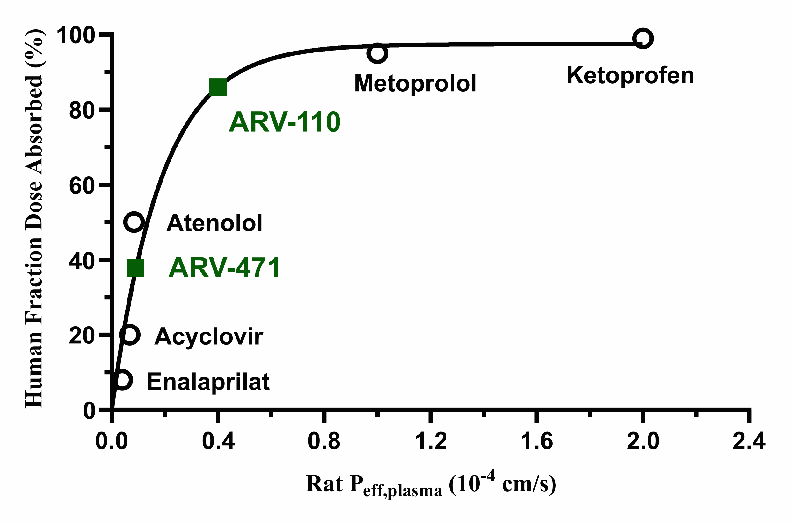
What are the absorption-limiting processes?
Biopharmaceutics
characterization
What could be the human f_{abs} potential of the PROTACs based on their P_{eff}?
We assume the administration of a formulation without solubility/dissolution limitations in intestinal drug absorption
Based on P_{eff} values generated in the same lab with the same method
10

Slide 11
What are the absorption-limiting processes?
Biopharmaceutics
characterization
What could be the human f_{abs} potential of the PROTACs based on their P_{eff}?
ARV-110 shows clear solubility/dissolution limitation
ARV-471 shows P_{eff}-related absorption ceiling on top of solubility/dissolution limitation (predominant limitation dependent on dose number)
Almost complete (87%) absorption possible
Absorption ceiling <40% of dose absorbed
Solubility/dissolution limitation very prevalent for PROTACs
11

Slide 12
How do PROTACs dissolve?
Biopharmaceutics
characterization
PROTAC colloidal dynamics
Formulation development
Biopharmaceutics toolbox for PROTACs
in vivo and in vitro assays
Comprehensive PROTAC characterization
Identifying absorption-limiting processes at clinically relevant doses
Mechanistic investigations of PROTAC luminal colloids
in vitro physicochemical characterization
of luminal colloids
in vivo effects of luminal colloids on PROTAC intestinal absorption
Implications for formulation design
Case study – How Permeation Enhancers (PEs) boost intestinal absorption
12

Slide 13
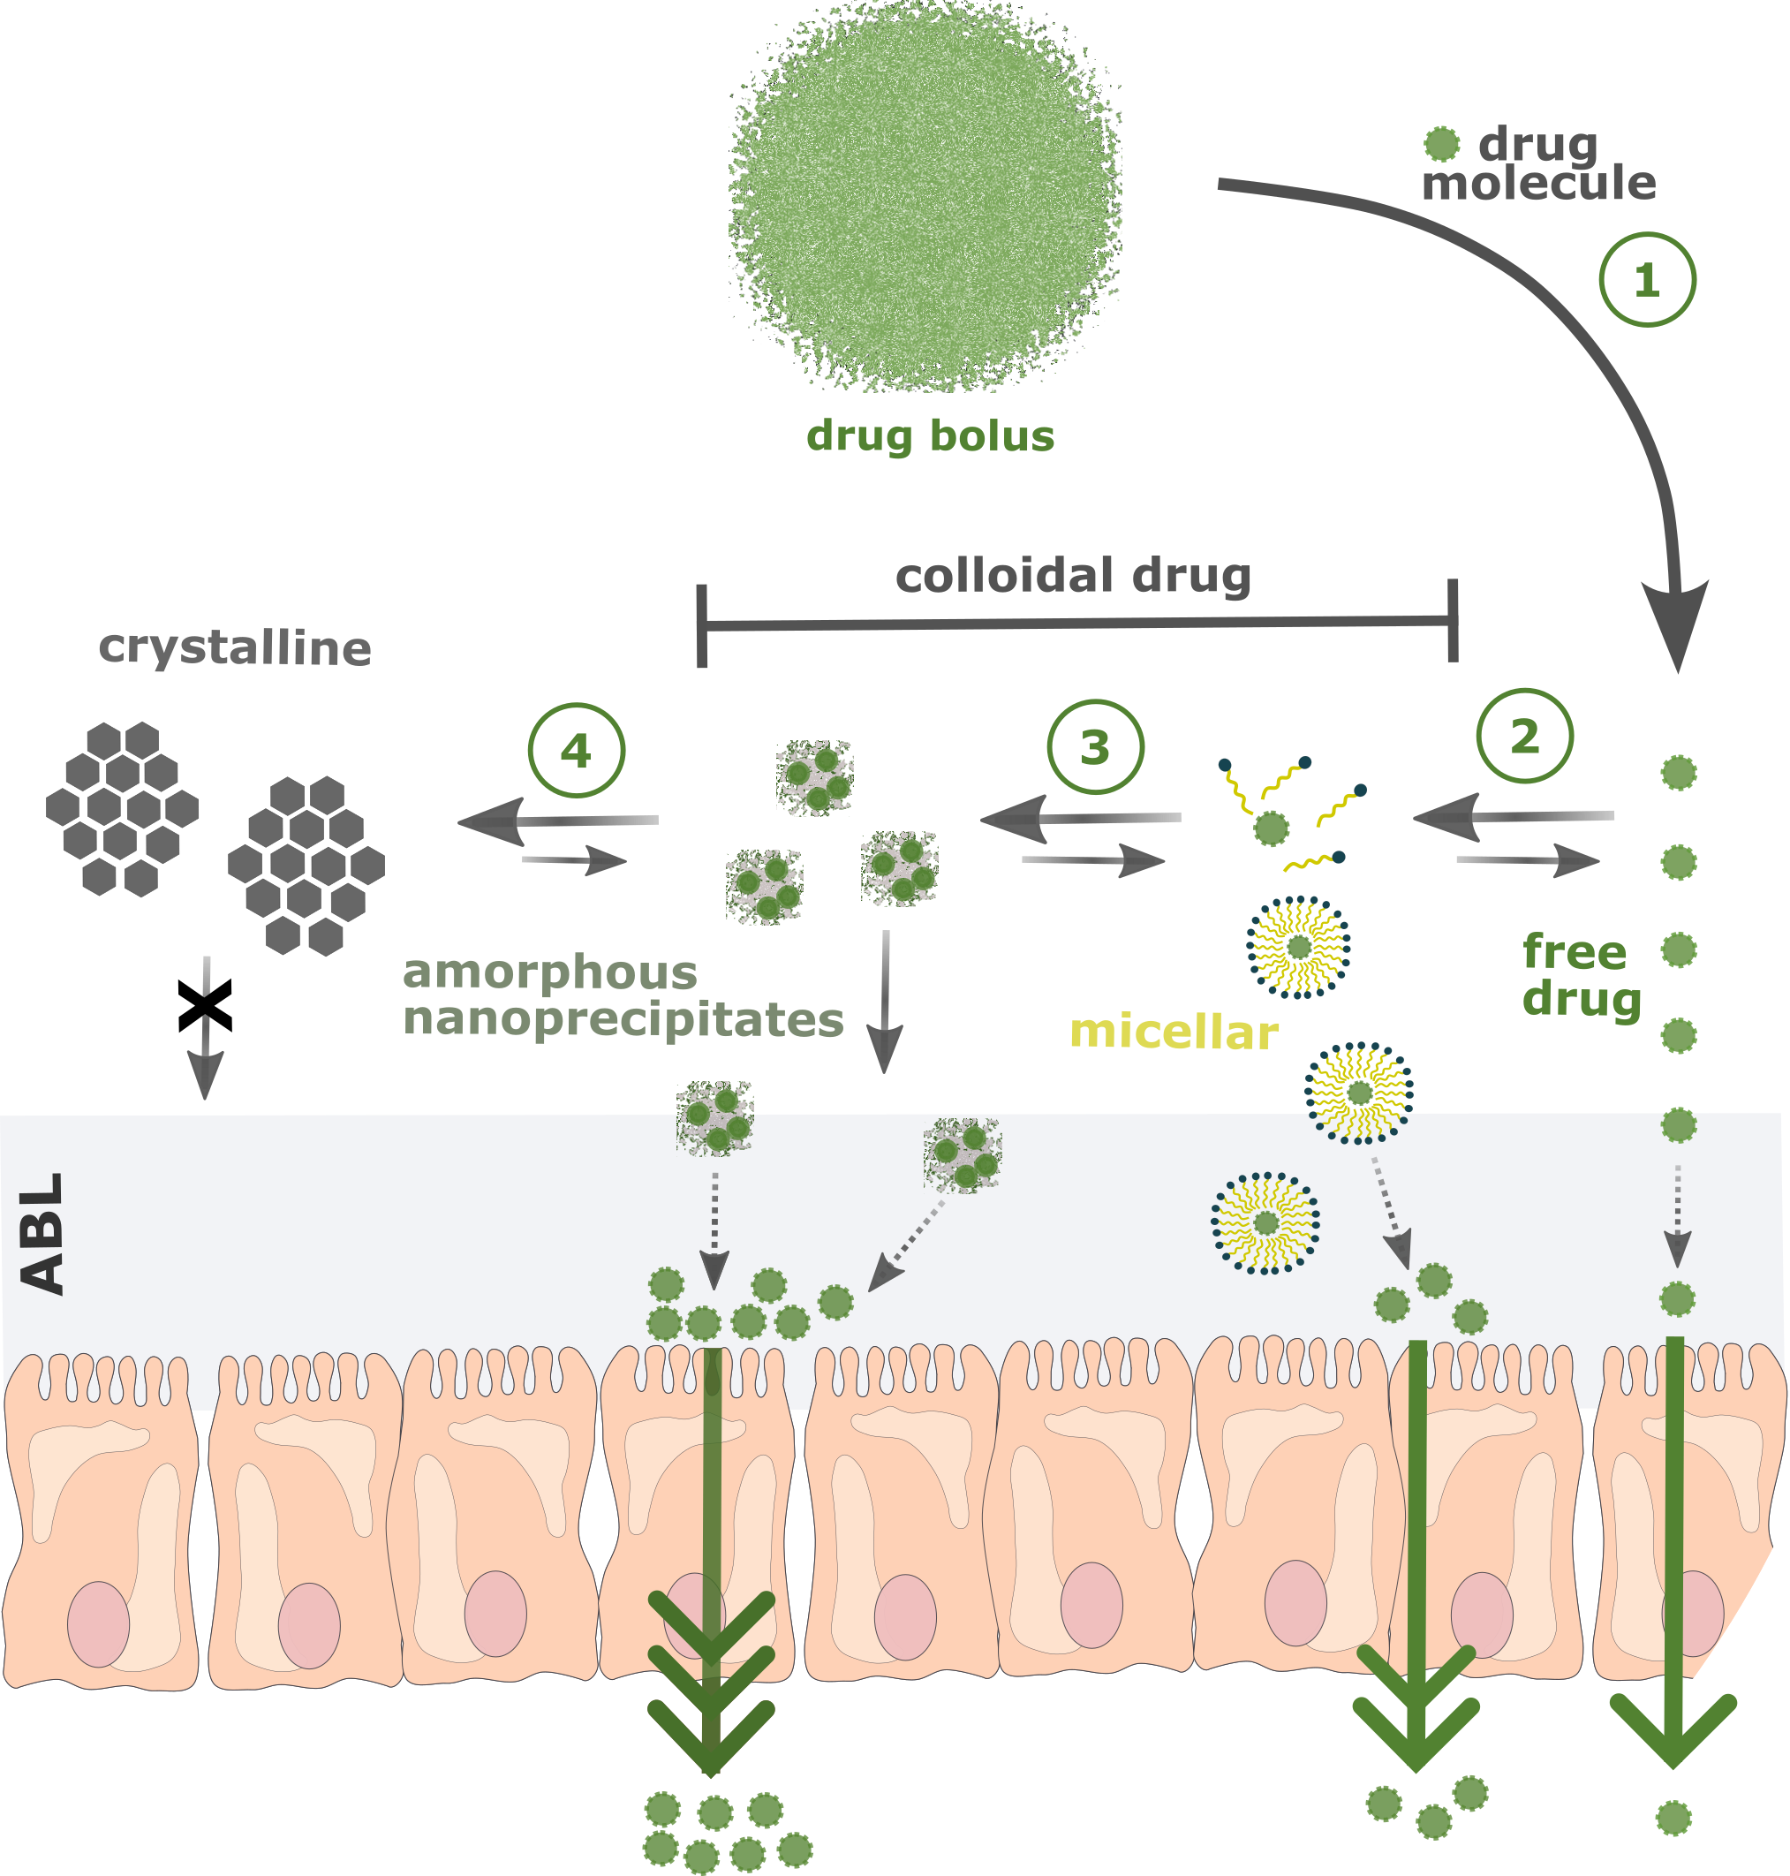
How do PROTACs dissolve?
Luminal colloidal dynamics
Solubility
Solubility of ARV-110 and ARV-471 in relevant media
Supersaturation potential
Dissolution & Precipitation
Identification and quantification of PROTAC species upon dissolution
Characterization of precipitates when overcoming solubility limits
DLS
Ultracentrifuge
WAXS
13

Slide 14
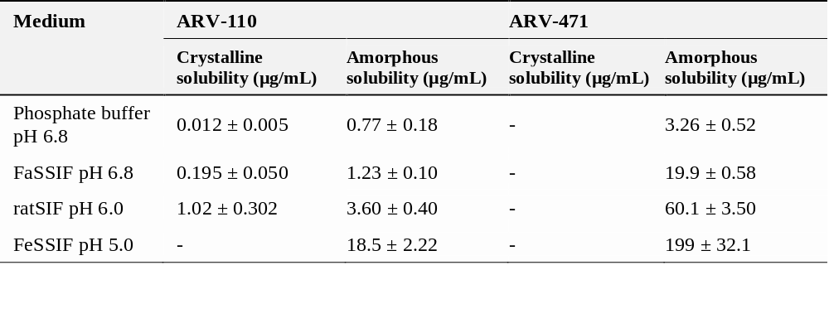
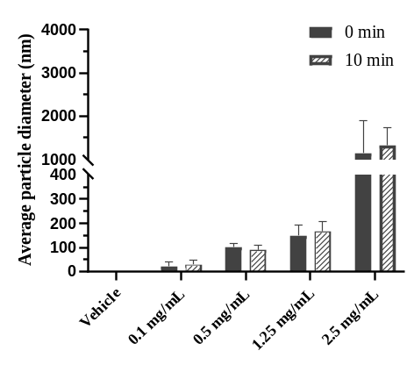
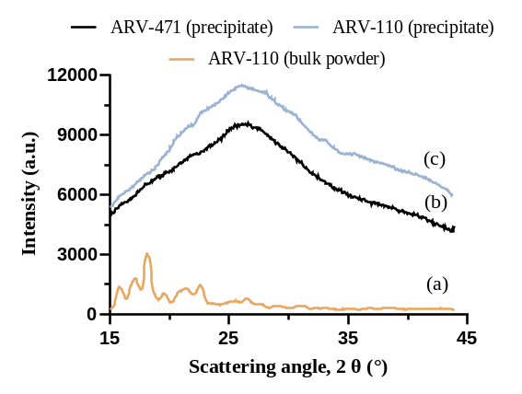
Luminal colloidal dynamics of PROTACs
Luminal colloidal dynamics
Solubility
x1.6
x6.1
Dissolution & Precipitation
ARV-471
>95% of dose
14

Slide 15
Luminal colloidal dynamics of PROTACs
Luminal colloidal dynamics
Dissolution & Precipitation
Formation of luminally stable amorphous drug nanoparticles (!) with no crystallization observed (10h) at highest doses
Crystalline solubility irrelevant for both PROTACs
At clinically relevant doses major fraction of PROTAC in vehicle in colloidal form (e.g ARV-471 (2.5 mg/kg) >95% colloidal)
15

Slide 16
>95% of dosed PROTAC is present as luminally stable colloids!
To understand PROTAC intestinal absorption we have to understand PROTAC colloids!

Slide 17
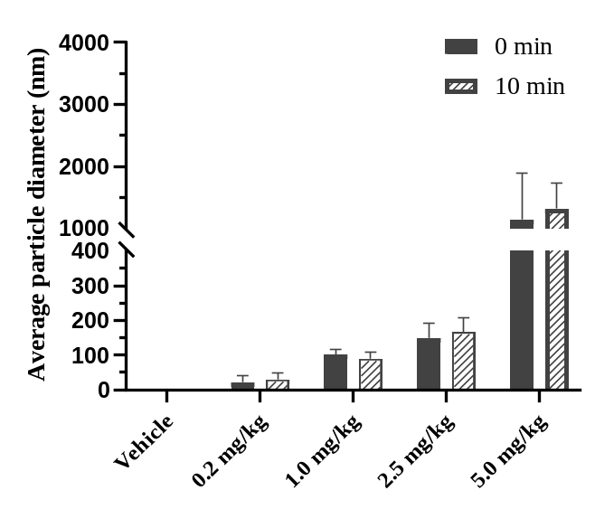
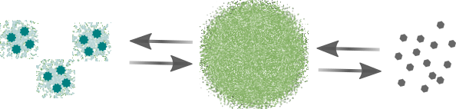
Understanding PROTAC colloids in vivo
Intraduodenal (ID) bolus
Dose escalation study with colloidal PROTAC formulation
Colloidal vs non-colloidal formulation
Comparing PROTAC intestinal flux from colloidal formulations at four ascending doses (0.2 – 5.0 mg/kg)
Increasing colloid size and concentration
Comparing PROTAC intestinal flux from colloidal formulation to a non-colloidal formulation at 1.0 mg/kg
Same vehicle, same solubilized drug concentrations (40 µg/mL), both amorphous, different size
ARV-471
Colloidal amorphous drug precipitates
Non-colloidal amorphous particles
102 nm
>>5 µm
17

Slide 18
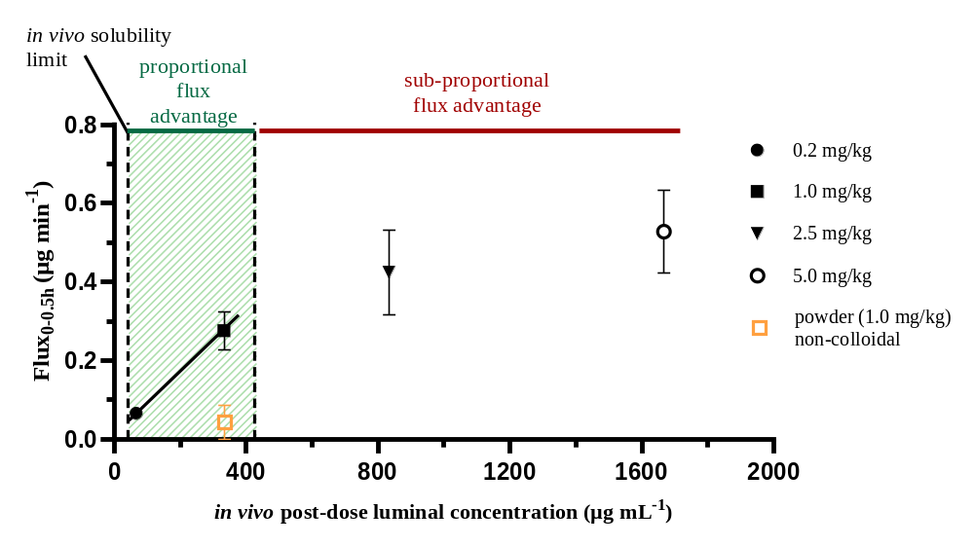
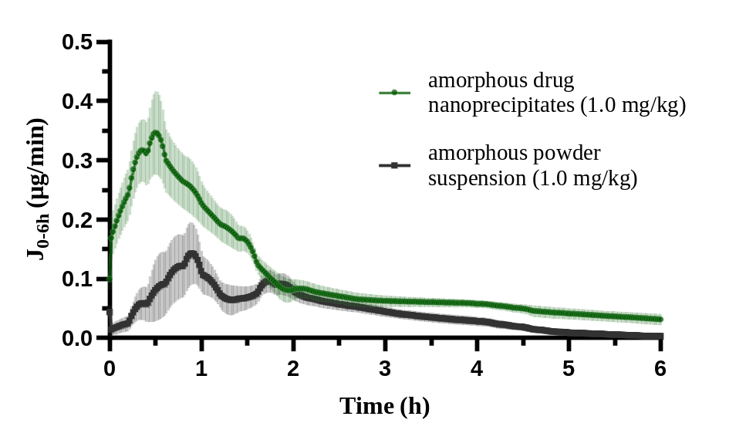
Effects of luminal nanoprecipitates on in vivo absorption
Intraduodenal (ID) bolus
Dose escalation study with colloidal PROTAC formulation
Colloidal vs non-colloidal formulation
ARV-471
Absorptive flux increases dose-proportionally up to 12-fold above ARV-471 solubility limit (14-fold for ARV-110)
Colloidal amorphous drug precipitates drive absorption up to certain particle concentration or size
7-fold enhanced flux_{0-0.5h} from colloidal formulation
No flux enhancement beyond solubility limit of non-colloidal formulation
17

Slide 19
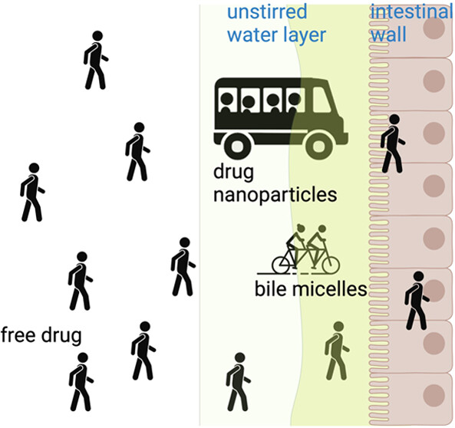
Mechanisms of enhanced drug absorption via colloidal drug species
Colloidal drug species drive absorption likely through different mechanisms:
Colloidal species like amorphous drug nanoprecipitates exhibit faster re-dissolution
  Luminal reservoir of nanosized drug enables constant equilibrium at solubility limit in intestinal lumen
  Might explain sub-proportional flux increases beyond solubility limit
Particle drifting effect:
Particle drifting enhances mass transport across aqueous boundary layer (ABL)
  Colloids traverse the ABL and act as readily dissolving reservoirs, raising free drug concentration directly at the epithelial surface
  Proportional flux increase well above solubility limit indicates that colloidal species can behave like solutes in the absorption process
Yang et al., 2024, Mol. Pharmaceutics
18
Notes:
- Colloids cross the ABL like free drug and immediately dissolve to replenish permeated drug at epithelium

Slide 20
Conclusions and implications for oral PROTAC development
Key take-aways:
PROTACs readily form colloidal, amorphous nanoprecipitates that are stable in the intestinal lumen
  These nanoprecipitates should not be dismissed as precipitated drug that is lost to absorption
  They should be properly characterized and understood to exploit them with suitable delivery systems
Non-standard molecules require non-standard testing approaches
  Integrate PROTAC-specific in vitro methods into mechanistic in vivo testing to understand intestinal absorption
  Luminal colloidal dynamics should be studied instead of solely solubility
19

Slide 21
PROTAC colloids in formulation studies
Biopharmaceutics
characterization
PROTAC colloidal dynamics
Formulation development
Biopharmaceutics toolbox for PROTACs
in vivo and in vitro assays
Comprehensive PROTAC characterization
Identifying absorption-limiting processes at clinically relevant doses
Mechanistic investigations of PROTAC luminal colloids
in vitro physicochemical characterization
of luminal colloids
in vivo effects of luminal colloids on PROTAC intestinal absorption
Implications for formulation design
Case study – How Permeation Enhancers (PEs) boost intestinal absorption
20

Slide 22
Case Study
Permeation Enhancers (PE) boost absorption through colloidal dynamics

Slide 23
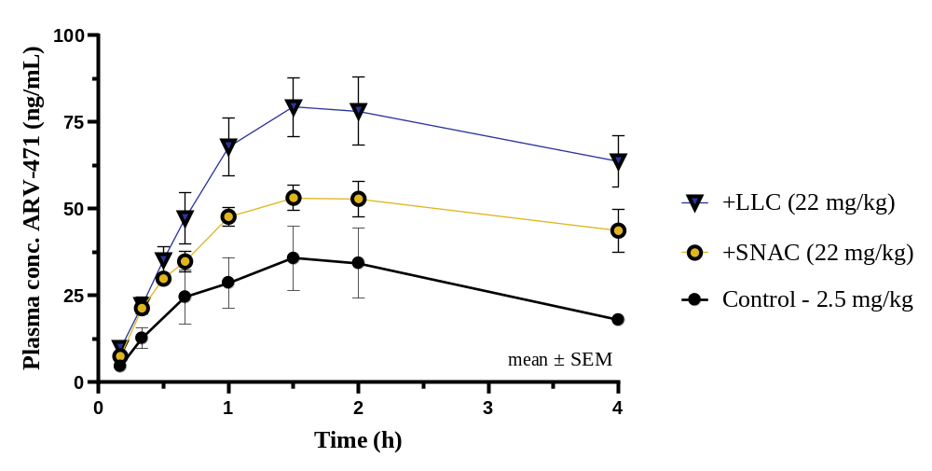
In vivo effect of PEs on intestinal absorption of ARV-471
Intraduodenal dosing of ARV-471 with PEs lauroyl-L-carnitine (LLC) & SNAC:
Key findings:
Marked increase in AUC_{0-4h} and Flux_{0-60 min} of ARV-471 with SNAC (↑ 71% and 67%) and LLC (↑ 147% and 110%)
P_{eff} enhancement (rat SPIP) of ARV-471 through SNAC (+150%) and LLC (+120%)
LLC shows lower P_{eff} enhancing effect but x2 higher absorption-enhancing effect
How can we explain the additional effect of LLC?
22

Slide 24
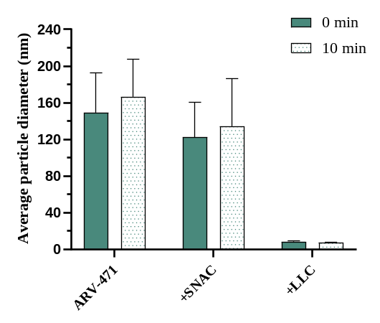
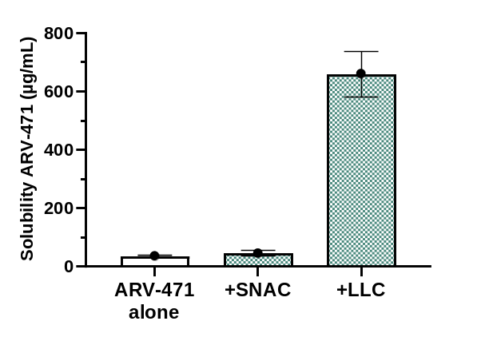
In vivo effect of PEs on intestinal absorption of ARV-471
How can we explain the additional effect of LLC?
Solubility and colloidal dynamics
Average diameter of ARV-471 colloids
in vivo apparent amorphous solubility of ARV-471
SNAC: Minor effect on solubility and colloid size = unchanged colloidal dynamics = pure P_{eff} effect
LLC: 19-fold apparent solubility increase, colloid size decrease (167 to 7 nm)
Absorption enhancement via dual mechanism: Direct membrane effect (↑P_{eff}) and solubilization effects (↑solubility, ↓colloid size)
23

Slide 25
Acknowledgements
Uppsala University:
David Dahlgren
Hans Lennernäs
Mikael Hedeland
AbbVie:
Mirko Koziolek
Anura Indulkar
Thomas Borchardt
Benjamin Ortiz Cardona
Steven Castleberry

